Slide 1

PHYSICS IN TRANSPORTATION part 1

Slide 2
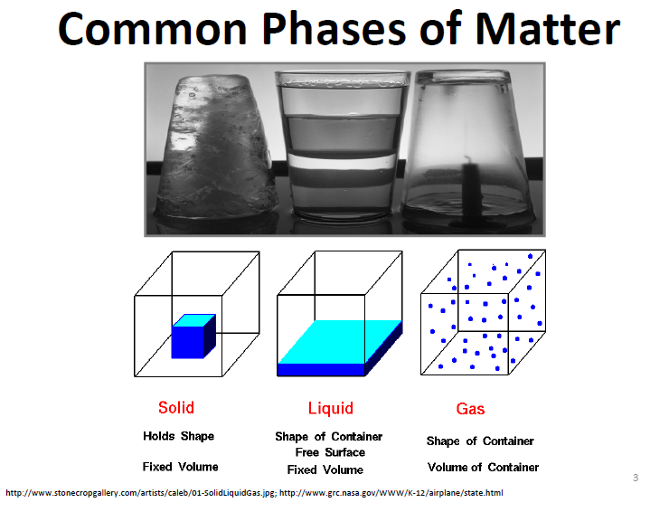

Slide 3
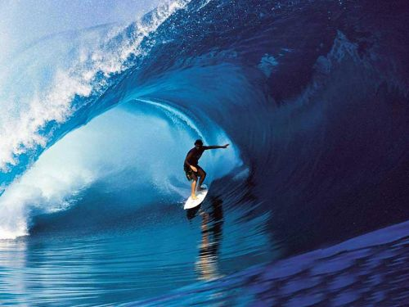
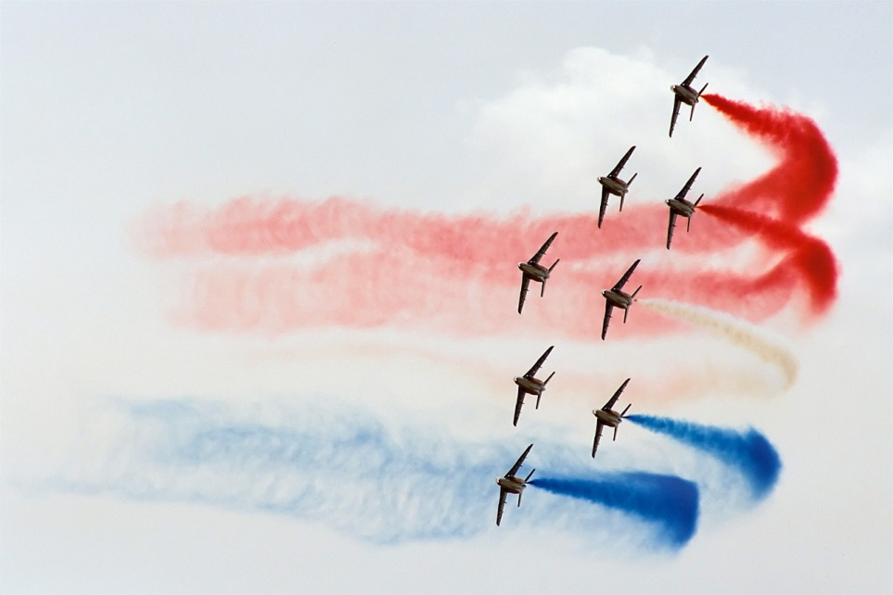
Fluids
- no definite shape and flow
- liquids and gases

Slide 4
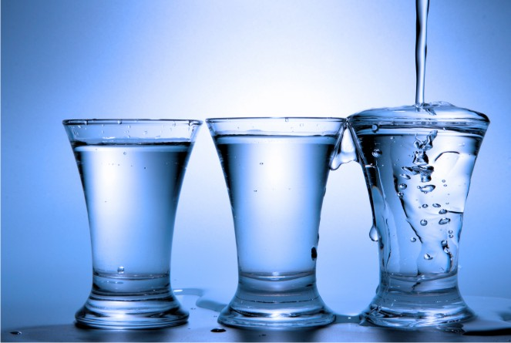
Liquid
flow under gravity until they occupy the lowest possible regions of their container

Slide 5
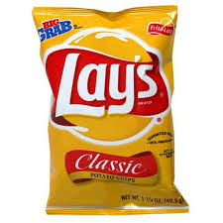
Gas
expand to fill their containers regardless of their shape

Slide 6
Fluid Mechanics
Fluid Statics – study of fluids at rest.
Fluid Dynamics – study of fluids in motion.

Slide 7
Density and Specific Gravity

Slide 8

Density, ρ
Amount of mass per unit volume
SI UNIT: kg/m³ [SI]
1 g/cm³ = 1,000 kg/m³

Slide 9
Sinking or Floating
Float
Sink
ρ_{object} < ρ_{fluid medium}
ρ_{object} > ρ_{fluid medium}

Slide 10
Sinking or Floating
water
Material | Density (g/cm³)
Water | 1
Air | 0.0013
Wood (oak) | 0.85
Aluminum | 2.7
Air bubbles
wood
Al

Slide 11
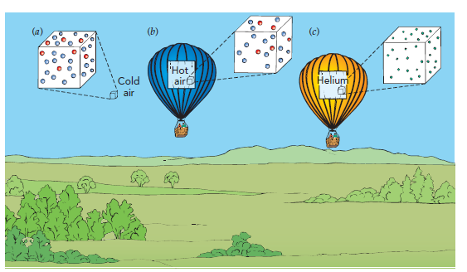
AIR BALLOONS
Compare the density of the following:
Cold air
Hot air
Helium

Slide 12
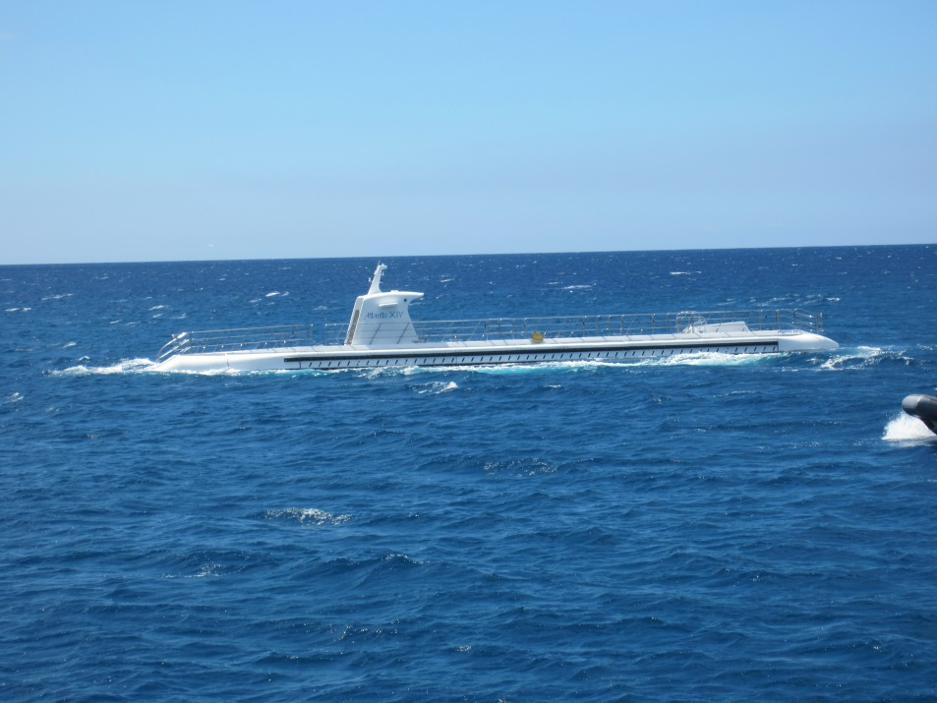

How do submarines work?

Slide 13
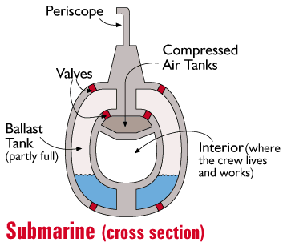
Submarine
Controls the density of submarine
Fill with water → high density
Remove water → low density

Slide 14
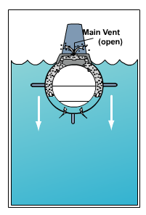
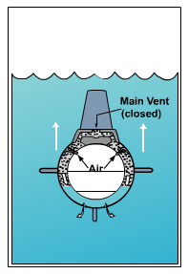
Submarine
To move down → take in water to increase density
To move up → remove water to decrease density

Slide 15
Specific Gravity / Relative Density
Ratio of the density of a material to a standard density.
Unit less
Material | Density (g/cm³)
Water (4°C) | 1
Oxygen (0°C) | 0.00143

Slide 16
Specific Gravity, SG
Material | Density (g/cm³)
Water | 1
Wood (oak) | 0.85
Aluminum | 2.7

Slide 17
Specific Gravity, SG
Float on water
Sink in water
SG < 1
SG > 1

Slide 18
Buoyant Force

Slide 19
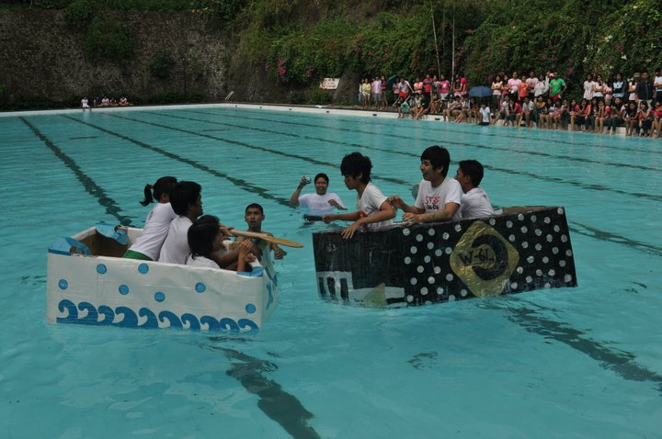
Buoyant Force
Net upward force that a fluid exerts on an object

Slide 20
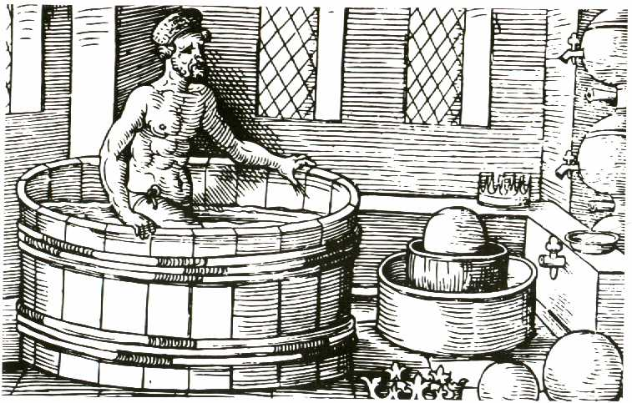
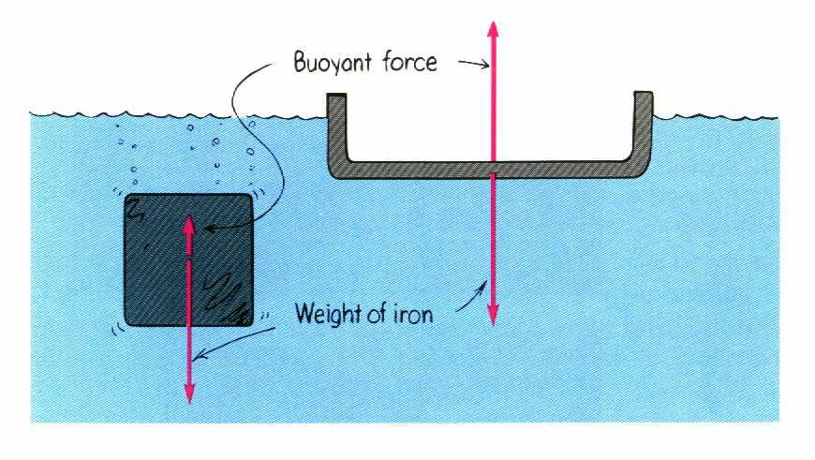
Ways of determining F_{B}
Force Analysis
Archimedes’ Principle

Slide 21
Archimedes’ Principle
Buoyant force (F_{B}) equal to the weight of the fluid displaced (W_{fl-displaced}).
Fluid displaced

Slide 22
Archimedes’ Principle
Fluid displaced
m = mass
V= volume
ρ_{f} = density of fluid

Slide 23
Force Analysis
For floating object:
F_{B}
W_{o}
W₀ = weight of object

Slide 24
Force Analysis
F_{B}
W_{o}

Slide 25
Force Analysis
F_{B}
W_{o}
If medium is water, then

Slide 26
Wooden boat floating on fresh water
S.G. (oak wood) = 0.85

Slide 27
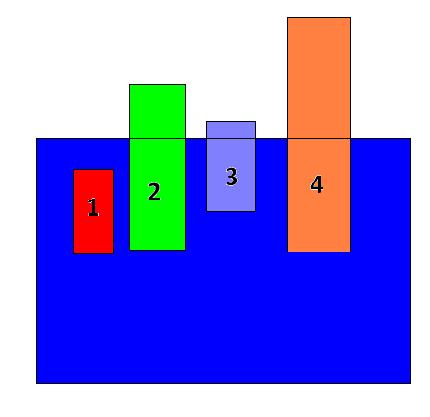
Exercise # 1
Rank the four materials in increasing densities/ specific gravity as they are submerged in water.

Slide 28
Answer
Object 1 | % submerged | S.G. | Rank
1 | 100% | >1 | 1
2 | 75% | 0.75 | 3
3 | 90% | 0.90 | 2
4 | 40% | 0.40 | 4

Slide 29
Exercise # 2
Two identical objects float on water, which object displaced greater volume of water?
O2
O1

Slide 30
Answer: Same
O2
O1
Same ρ_{f} (water)
Same W_{o} (identical object)
Therefore: Same V_{fl-displaced}

Slide 31
Exercise # 3
Boat A floats on fresh water while boat B floats on salt water. Boat A and boat B have the same mass. Salt water has higher density than fresh water.
Which of the two boats experience greater amount of buoyant force?
Which of the two boats will sink deeper?

Slide 32
Answer: Same F_{B}
Which of the two boats experience greater amount of buoyant force?
For objects that floats:
Boat A and boat B have same weight, thus they will have same Buoyant force

Slide 33
Ans: Boat in fresh water
b) Which of the two boats will sink deeper?
Sink deeper → larger volume displaced
Fresh water: lower density, thus higher volume of fluid displaced, thus sink deeper

Slide 34
Force Analysis
For object that sink:
T
F_{B}
W_{o}
T = Tension of string

Slide 35
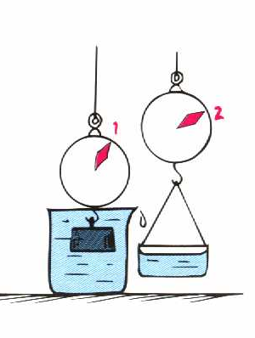
Force Analysis
Tension, T = weight in fluid
weight in fluid is lesser than actual weight

Slide 36
Object that sink
For object that sink (completely submerged), V_{o} = V _{fl-displaced}

Slide 37
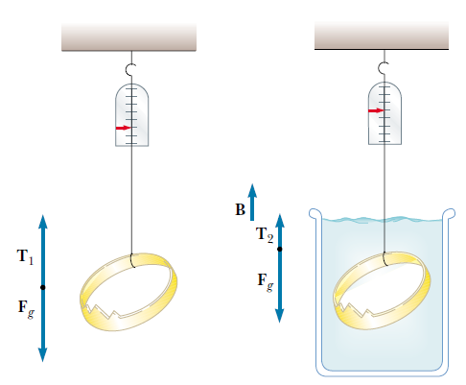
SG of gold = 19.3
Gold or not?
Archimedes supposedly was asked to determine whether a crown made for the king consisted of pure gold. Legend has it that he solved this problem by weighing the crown first in air and then in water, as shown in the figure.
Suppose the scale read 7.84 N in air and 6.86 N in water. What should Archimedes have told the king?

Slide 38
Answer: Not Gold
Weight in air = 7.84 N
Weight in water = 6.86 N
S.G. (gold) = 19.3

Slide 39
Pressure

Slide 40
Pressure, P
Force (F) per unit area (A)
Units:
pascal (Pa) = N/m²
bar, atmosphere(atm), mm Hg, torr, lb/in²

Slide 41
Pressure (Solid)
W = 8 N
A = 4 m²
The “8N” force is distributed along the 4m² area, therefore every point along the 4m² area is experiencing “2 Pa of pressure”

Slide 42
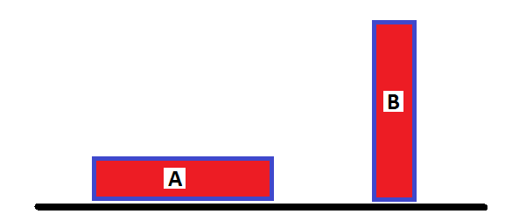
Exercise # 1
Which block exerts the greater pressure on the surface? (Assume the two blocks are identical)

Slide 43
Answer
Block B because it has smaller area of contact with the floor

Slide 44
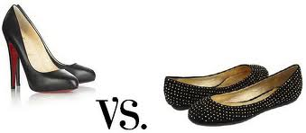
Exert Higher Pressure on the floor?

Slide 45
Answer

Slide 46
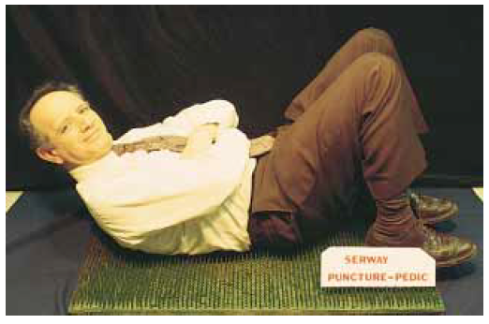
Bed of Nails
After a long Lecture, the daring professor stretches out for a nap in a bed of nails, how is this possible?

Slide 47
Answer
The weight of the professor is distributed on the set of nails, thus the pressure decreases.
High pressure
“very dangerous”
Lesser pressure
“ less dangerous”

Slide 48
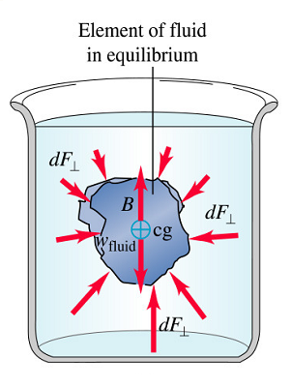
Fluid Pressure
Force (perpendicular to the surface) per unit area exerted by fluid on an object

Slide 49
Fluid Pressure
ρ = density
g = acceleration due to gravity
h = depth

Slide 50
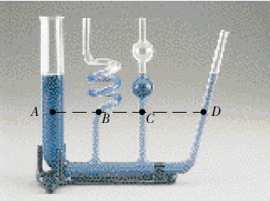
Fluid Pressure, P
Increase with fluid density (ρ) and depth (h)
Does not depend on the shape of the container or volume of fluid
h
Same pressure

Slide 51
Exercise
h
A
B
C
All the vessel contains the same kind of fluid (same fluid density), which set-up experiences higher fluid pressure at the bottom?

Slide 52
Answer: Same
h
A
B
C
Same depth, same fluid density → same fluid pressure
Note: The treatment in “fluid” is different from that of “solid”

Slide 53
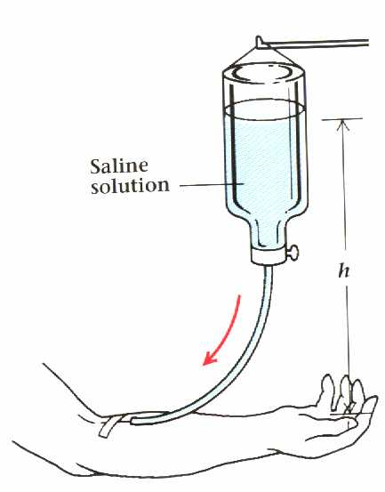
Problem
A nurse administers medication in a saline solution to a patient by infusion into the patient’s arm. The density of the solution is 1 x 10³ kg/m³. And the pressure inside the vein is 2.4 x 10³ Pa. How high must the container be hung?

Slide 54
Solution
p_{liquid} = p_{vein} ρgh = p_{vein} solving for h:
H = 0.24 m

Slide 55
Pascal’s Principle
5 Pa
Pressure applied to an enclosed fluid is transmitted undiminished to every portion of the fluid and the walls of the enclosing vessel.
0 Pa
+5 Pa
1 Pa
+5 Pa
2 Pa
+5 Pa
3 Pa
+5 Pa

Slide 56
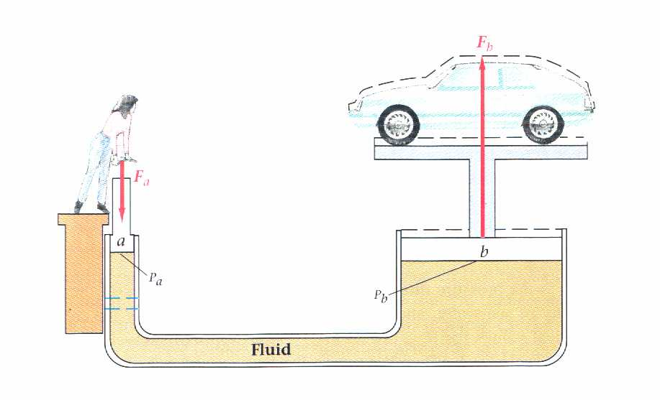
Application: Hydraulic Lift
P₂
Apply pressure
P₁
Pressure transmits in fluids
If (A₂/A₁)=1000, force increases 1000x

Slide 57
Absolute Pressure
Po= 5 Pa
P_{o} = pressure at the surface of the fluid
0 Pa
+5 Pa
1 Pa
+5 Pa
2 Pa
+5 Pa
3 Pa
+5 Pa

Slide 58
Absolute Pressure
Po= atmospheric pressure
If the fluid surface is exposed to the atmosphere, then, P_{o} = atmospheric pressure
At sea level:
P_{o}= 1.013 x 10⁵ Pa = 1 atm

Slide 59
Absolute Pressure
Air pressure decreases with altitude

